Slide 1
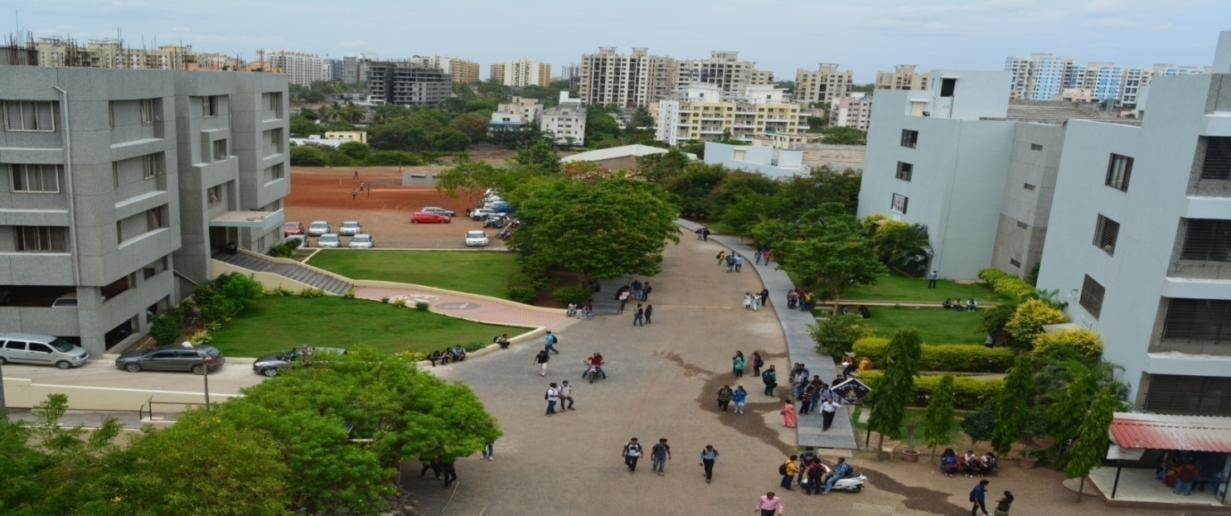
Bansilal Ramnath Agarwal Charitable Trust’s
Vishwakarma Institute of Information Technology, Pune
Department of AI & DS

Slide 2
Batch-A3
Dictionary using Binary Search Tree
Name | Roll No | PRN
Sangini Sangle | 271049 | 22010240
Nidhi Sanklecha | 271051 | 22010705
Ayush Shende | 271056 | 22010714
Suraj Wadikar | 271064 | 22010274
Abhishek Walunj | 271065 | 22010286

Slide 3
Outline
Brief
Task
Introduction
Motivation
Resources
Issues and Challenges
Proposed Work
Results and Discussion
Conclusion and Future Work
References

Slide 4
Brief
A dictionary is a data structure that maps keys to values and allows querying the value for a given key. A binary search tree also has keys (which are used for the search) and can also have further payload data (the values). So a BST with payload data is actually already a dictionary.
In this project, we will use a binary search tree (BST) representation to implement a simple dictionary ADT.
The implementation must use a binary search tree (BST) to maintain the contents of the dictionary. Dictionary items are represented using BST Node objects which must be allocated dynamically.
To simplify, a BST Node elides the value part of a key-value pair and only stores the symbolic key in the form of a C-style string. The key symbol must be dynamically allocated , too.

Slide 5
Task
The objectives for this project are:
To implement a simple dictionary ADT using a binary search tree.
Insert the words into the dictionary.
Read dictionary word list and store into a temporary data structure
Look up the words in the dictionary
Search the meaning of word in dictionary.

Slide 6
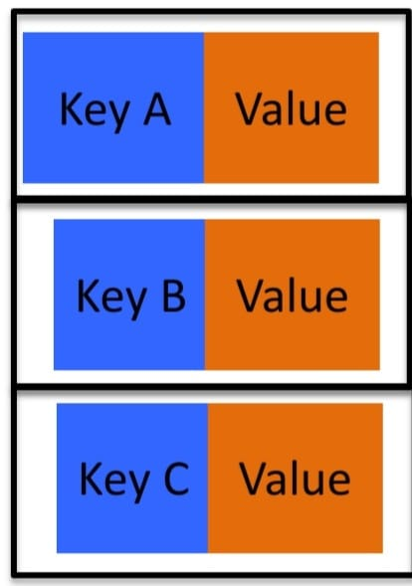
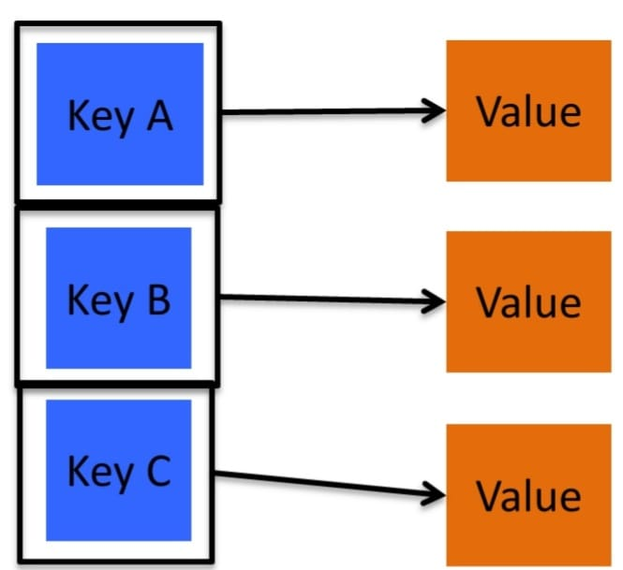
Introduction
Search is a fundamental process in data processing . The search process is to find a certain value (data) in a set of data of the same type
Items, such as names, numbers, etc. can be stored in memory in a sorted order called binary search trees or BSTs. And some of these data structures can automatically balance their height when arbitrary items are inserted. Therefore, they are known as self-balancing BSTs.
A Binary Search Tree is a sorted binary tree in which all the nodes have following two properties−
1. The right sub-tree of a node has a key greater than to its parent node's key.

Slide 7
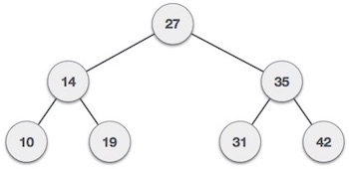
2. The left sub-tree of a node has a key less than or equal to its parent node's key.
Following is a pictorial representation of BST −
We observe that the root node key (27) has all less-valued keys on the left sub-tree and the higher valued keys on the right sub-tree.

Slide 8
Motivation
The motivation is to obtain a data structure with more power than a contiguous array in memory.
To find the meaning of words, there is no need to open a dictionary from the beginning page to the end of the page one by one, but look for it by separating or dividing it into two parts
The main reason to use a binary search tree is the fact that it extends the capability of a normal array.
Implementing a binary search tree is useful in any situation where the elements can be compared in a less than / greater than manner. For our example, we'll use alphabetical order as our criteria for whether an element is greater than or less than another element

Slide 9
Issues and Challenges
Programming binary search algorithm is error prone and difficult.
The main Challenge is that we should always implement a balanced binary search Otherwise the cost of operations may not be logarithmic and degenerate into a linear search on an array.

Slide 10
Conclusion
From the results of the discussions that have been carried out, it can be concluded as follows:
1.The search process on the Dictionary using binary search tree algorithms works well.
2.The Binary Search Algorithm successfully finds every word that is searched if the word is available in the dictionary. The basic principle of the binary search algorithm is to repeat the search space repeatedly until data is found or until the search space cannot be shared (data may not exist).
3. The purpose of searching using a binary search algorithm is to reduce the number of operations that must be compared between the data sought and data in the Dictionary, especially for large amounts of data.

Slide 11
References
http://sandsoftwaresound.net/wp-content/uploads/2013/07/S05_project7.html
https://www.tutorialspoint.com/data_structures_algorithms/binary_search_tree.htm
https://www.youtube.com/watch?v=JS297Hq4Mz8
https://opendsa-server.cs.vt.edu/ODSA/Books/CS3/html/BSTDict.html
https://www.researchgate.net/publication/335657221_Digital_Dictionary_Using_Binary_Search_Algorithm

Slide 12
THANKS

